Slide 1
Adobe Hackathon
May 10 2017

Slide 2
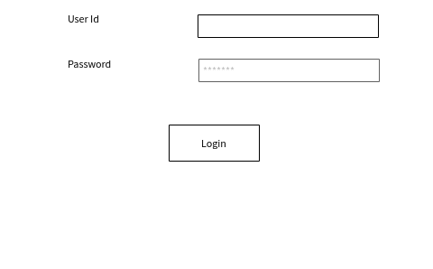

Slide 3
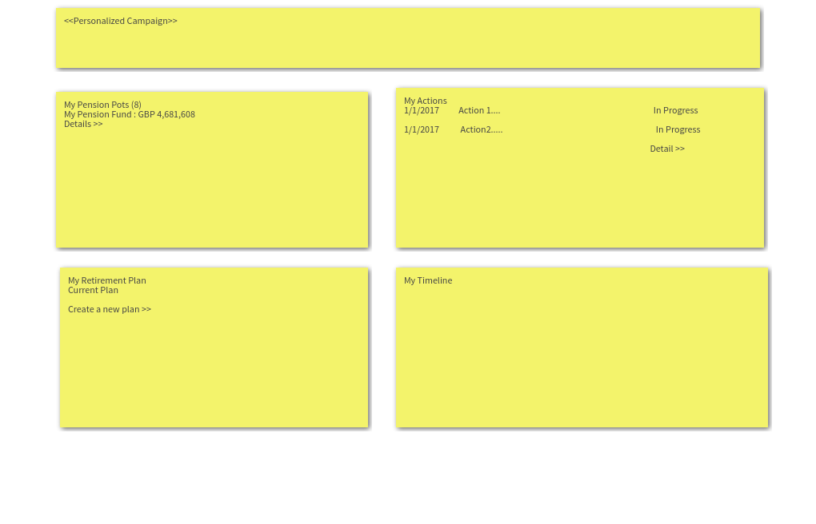

Slide 4
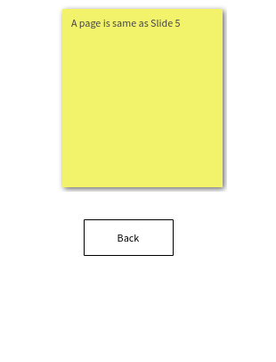
Correction in above fig – Slide 6 of Pension Dashboard Storylinev0.3.pptx

Slide 5
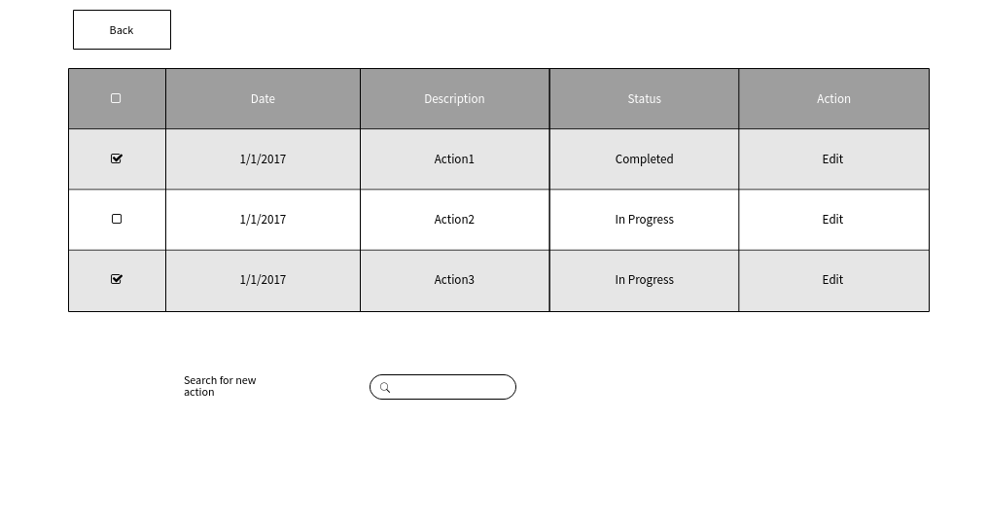

Slide 6
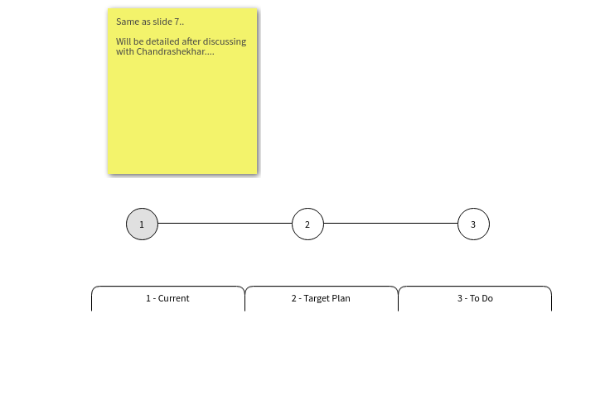
Correction in above fig – Slide 8 of Pension Dashboard Storylinev0.3.pptx instead of slide 7

Slide 7
